Slide 1
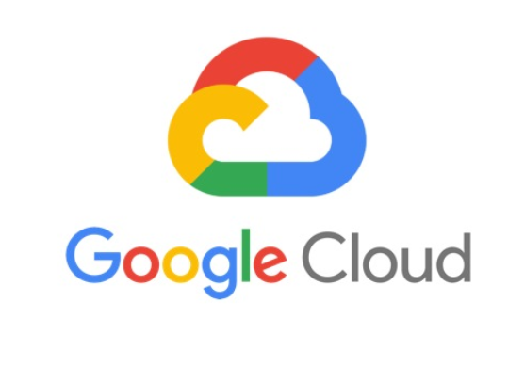
GCP – CDL - Cheat Sheet

Slide 2


Compute
VMWare
Virtual Machine
Use Cases: Virtualization, cloud computing, disaster recovery, development and testing.
Use Cases: Development, Testing, Scalability, High availability, Disaster recovery.
Offers full management for VMware workloads.
New and innovative solutions for businesses
Consolidate workloads with VMware to save space and energy costs.
Enhance disaster recovery with VMware for swift, seamless failover options.
improve performance optimization using features like load balancing and resource pooling.
t’s a Virtual Machine service in cloud
Choose from predefined machine types, size and configuration
Automatically adjust VM count based on traffic with automatic scaling
Different types of discounts in VM's are Sustained use , committed use, spot.
Distribute traffic across VMs for continuous application availability with load balancing.
Disk types include Standard, SSD, Balanced, Extreme, and Local SSD.
Allowing users to work with virtualized resources rather than directly with physical hardware.
Capabilities for automating tasks and processes

Slide 3
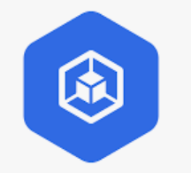

Compute
GKE
Anthos
Use Cases: Scalable container orchestration for cloud-native apps and microservices.
Use Cases: Hybrid and multi-cloud application deployment and management
Autopilot mode: CPU, memory, and compute resources that are provisioned for your Pods.
Standard mode: You are billed for each instance according to Compute Engine's pricing.
Horizontal pod autoscaling can be based on CPU utilization or custom metrics.
Offers real-time insights, automated reports, and secure innovation.
Use multi-cluster services for cross-cluster communication
Use Anthos for a unified management experience
Kubernetes at its core
Service mesh for connectivity
Istio for traffic management
Config management for consistency
Security scanner for vulnerabilities
Logging and monitoring for visibility
Central dashboard for control
CLI and API for automation
Runs on any infrastructure
Supports any workload
Traffic Management: Distributes incoming traffic across multiple pods or VMs within a Kubernetes cluster, ensuring high availability and performance.
Global load balancing capabilities, enables route traffic to workloads across multiple regions and zones, enhancing scalability and disaster recovery.

Slide 4
Serverless
Cloud Run
Cloud Function
App Engine
Use Cases: Websites & web applications, APIs & microservices, Scheduled workflow
Use Cases: Virtual assistance applications, Serverless mobile back ends, IoT processing.
Use Cases - Scalable mobile backends, Modern web applications.
Write code in any language, any library, and any binary.
Run containers directly on top of Google's scalable infrastructure.
Code can either run continuously as a service or as a job.
Scales out to handle all incoming requests or increased CPU utilization outside requests if CPU allocation is always on.
Scale to zero and minimum instances.
Automatically build container images from your source.
FAAS framework to run functions across multiple environments and prevent lock-in.
Develop faster by writing and running small code/function snippets that respond to events.
Function is triggered when an event being watched is fired.
Fully managed environment, requiring no infrastructure setup or server management.
Executes securely in isolated context, auto-scales, and has independent lifecycle..
Fully managed, serverless platform for developing and hosting web applications at scale.
Build your application in node.js, java, ruby, C#, go, python, or PHP.
Works in two environments namely standard and flex.
Automatically routes the incoming traffic to different applications.
Enables users to define access rules in the engine’s firewall and utilize SSL/TLS certificates on custom domains for free.
Designed for cloud environments and Scalable
No need to manage servers..

Slide 5
Serverless
API Gateway
APIGEE
Use cases - Chat applications, Multi-service integration.
Use cases - Connected apps, Updating legacy applications.
Create, secure, and monitor APIs for Google Cloud serverless back ends, including Cloud Functions, Cloud Run, and App Engine.
Built-in mechanisms, including authentication and key validation, help protect services published online.
Serves as an entry point for apps using backend services.
Allows for efficient distribution of traffic and ensures proper load balancing among target endpoints.
Uses Identity and Access Management (IAM) to control access to your API.
Offers high-performance API proxies to create a consistent, reliable interface for backend services.
API proxy layer between backend services and internal/external clients that want to use services.
Provides an array of policies that allows to add security, traffic management, data mediation, and extensions.
Offers features designed specifically to meet the needs of API producers and consumers.
Manage APIs: Both - manage APIs by routing requests and applying policies.
Security: Provide security features like authentication and authorization..

Slide 6
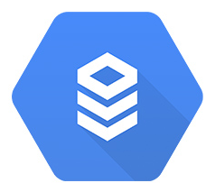
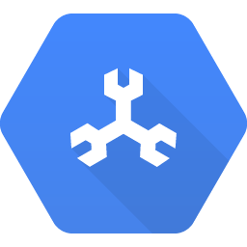
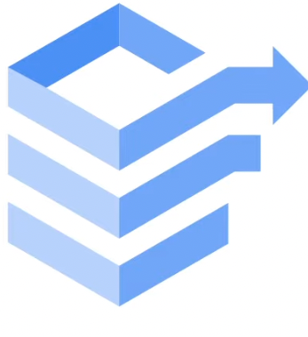
Database - Relational
Cloud SQL
Cloud Spanner
Data Migration
Use Cases: CRM, ERP, ECommerce and Web, SaaS application
Use Cases: Gaming, Retail, Supply chain/inventory management
use cases: Consolidation, Upgrading, Disaster recovery, Compliance
Fully managed relational database
Works with MySQL, PostgreSQL and SQL Server.
Setup the instance by providing location, configuration, storage type.
Automated backups and point-in-time recovery options.
Simplified Migration process using Database Migration Service
Data is encrypted at rest and in transit.
Globally-scaled, managed database with high availability
Ensures transactional consistency through automatic replication.
Merges relational database benefits with horizontal scale.
Nodes in Spanner provide compute, serving transaction requests without data storage.
Each node and database storage are replicated in three zones.
True Time synchronizes clocks in multiple datacenters.
Migrate data to the cloud with minimal downtime.
Supports a variety of data sources, databases, files, and applications.
Automated and secure data migration process.
No upfront investment.
Easy-to-use interface and intuitive workflows.
Real-time data replication ensures data integrity.
Built-in data validation to ensure data accuracy.
Fully managed, Highly scalable, Secure, Cost-effective
Strong Consistency

Slide 7
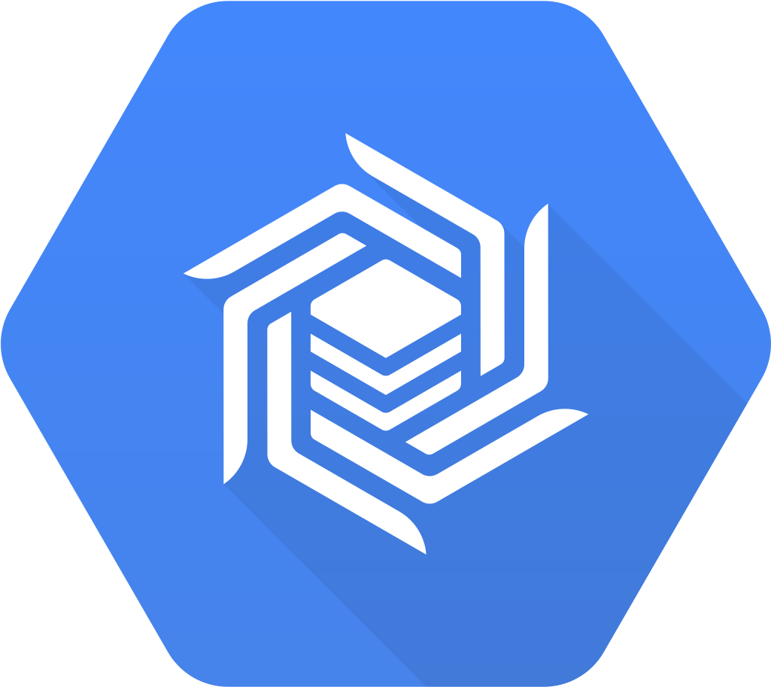

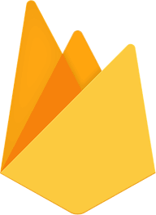
Database – No-SQL
Big Table
Fire Store
Firebase
Use Cases: Personalization, AdTech, Recommendation Engines, Fraud detection
Use Cases: Mobile/web/IoT applications, Real-time sync, Offline sync
use cases: Real-time collaboration, user authentication, push notifications, analytics.
Fully managed NoSQL database with high performance and 99.999% availability
Optimized for low latency, high read/write volumes, and performance at scale.
Replication enhances data availability and durability.
Data is encrypted with Google keys by default
Allows 4 replicated clusters in available Google Cloud zones.
By separating processing and storage, adjusts throughput automatically
Scalable document database service for diverse platforms.
Store your data in documents, organized into collections.
Syncs data across devices and efficiently handles one-time fetch queries.
Offers Google Cloud's robust infrastructure with multi-region data replication.
By separating processing and storage, adjusts throughput automatically
Caches data for offline access.
Mode type – Native (Document) and Datastore (Entity)
Comprehensive platform for building web and mobile applications.
Full-fledged Backend as a Service (BaaS) platform
Flexible, scalable database for mobile, web, and server development.
Secure user sign-ins via various authentication providers
Run backend code in response to events triggered by Firebase features.
Real-time synchronization, flexible schema.
Horizontal scalability for dynamic data storage needs in modern applications.

Slide 8
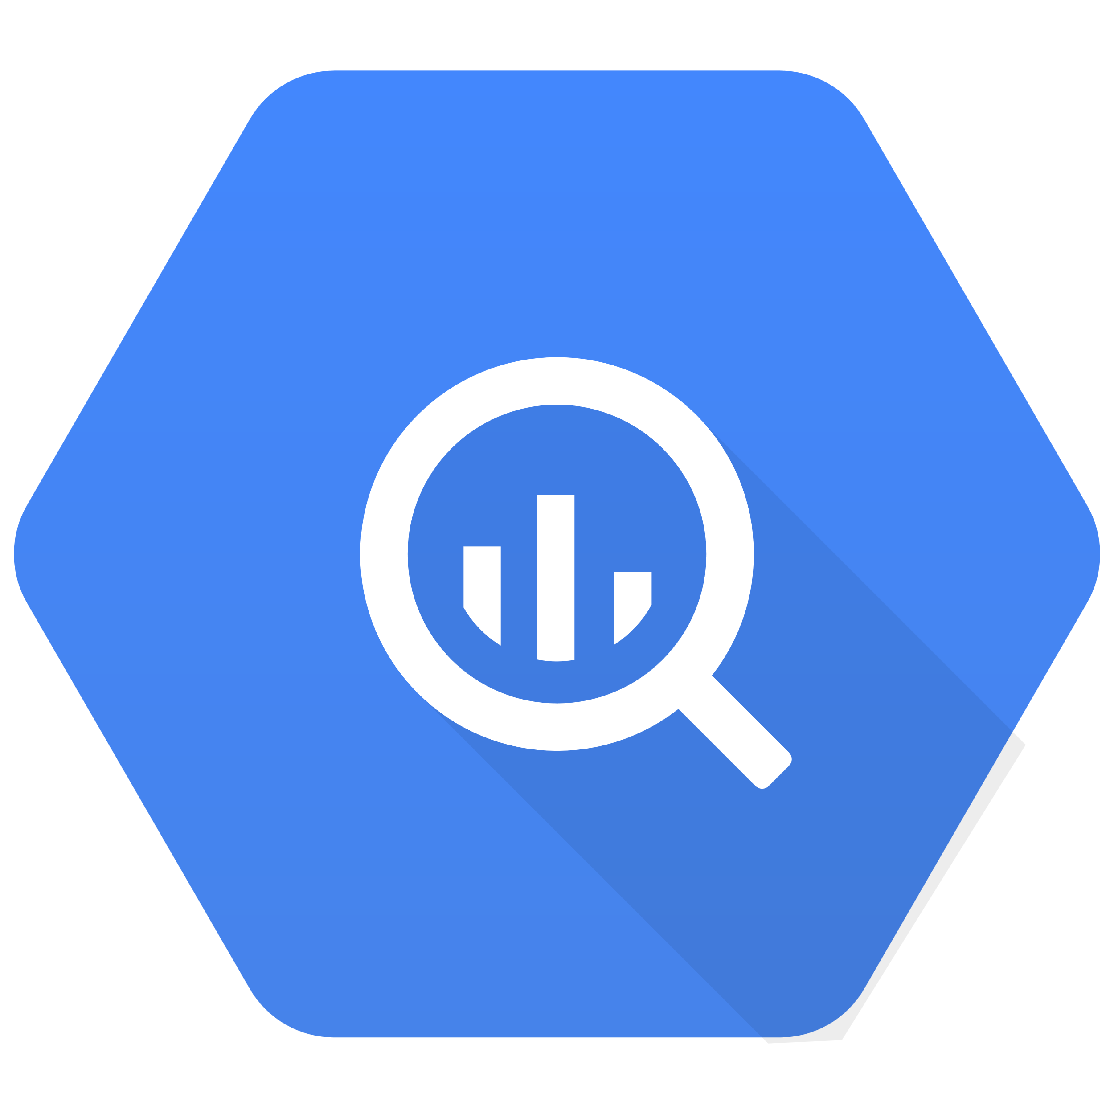
Analytical Service
Big Query
Big Table
Use Cases: Large-scale data analytics, business intelligence, and machine learning.
Use Cases: Storing large, sparse data sets (like web tables, time series, logs, sensor data)
Relational
Fixed and Enforced
SQL
ACID
Data stored on Google Cloud Storage
Data is automatically replicated across multiple regions for high availability and disaster recovery
Scales automatically to handle massive datasets
Optimized for analytical queries
Pay per use based on data stored and queries run
Data warehousing, analytics, reporting
Key-Value
Flexible
NoSQL
Primarily supports strings and integers
Eventually Consistent
Data geographically distributed
Data is automatically replicated within a cluster
Horizontally scalable by adding nodes to the cluster
Optimized for high-throughput read/write operations
Pay per use based on storage, read/write operations, and node hours
Real-time data serving, NoSQL databases
Highly scalable, can handle massive amounts of data.
Suitable for storing and analyzing large datasets.

Slide 9
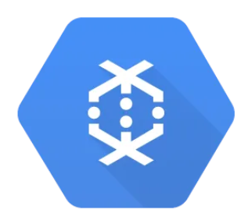
Data Pipeline
Dataflow
Use Cases: Real-time data processing stream analytics, ETL pipelines, machine learning.
For building complex data processing pipelines involving large-scale batch or streaming data tasks.
Complex data processing
Data processing service that can process vast amounts of data quickly and reliably.
Can process data in a variety of formats, including JSON, CSV, and Apache Avro.
Variety of sources, including Cloud Storage, BigQuery, and Pub/Sub.
Use Apache beam framework to create custom or predefine pipelines.
Used for data processing and integration Horizontal scalability for dynamic data storage needs in modern applications.
Fully managed Serverless Services, autoscaling based on requirement

Slide 10
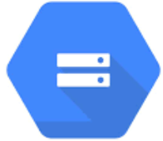
Storage
Cloud Storage
Use Cases: Backups and archives, Media content storage and delivery, Data lakes
Store any amount of data in any format.
Regional, dual-regional and multiregional data storage support.
99.999999999% durability and 99.99% availability.
Storage classes to choose from, including Standard, Nearline, Coldline, and Archive.
Manage lifecycle of objects, including deletion and archival.
Multiple versions for data recovery and rollback.
Manage Cloud Storage using a RESTful API (JSON), SOAP API(XML).
Encryption and access control to protect data.
Scalability, Durability, Accessibility, Security

Slide 11
Security Services
Cloud Armor
Cloud Identity
Use Cases: Bot Management, Tuning Google Cloud Armor WAF rules, Rate limiting
Use Cases: : Across All Industries .
Protect against distributed denial-of-service (DDoS) attacks.
Distribute traffic across multiple servers.
Pre-configured WAF rules
Terminate SSL/TLS connections at the edge of the network.
Limit the number of requests.
Custom rules to define specific security policies.
Preconfigured rules to protect against common threats.
Manage Cloud Armor using a RESTful API.
Cloud Identity is a comprehensive identity and access management (IAM) solution
Centrally manage users and groups
Enforce access control and Use fine-grained access controls
Enable single sign-on (SSO)
Allows users to sign in to all of their GCP resources with a single set of credentials.
Protect against unauthorized access and use multi-factor authentication (MFA)
Shared responsibility: Google protects the infrastructure, you secure your data and applications.
Defense in depth: Multiple layers of security safeguard your data and resources.

Slide 12
Security Services
Secret Manager
Use Cases : Storing and managing secrets, Compliance reporting
Is a cloud-based security service
helps you to manage and protect your secrets
Secrets are sensitive data, such as passwords, API keys, and certificates
Reduce the risk of a security breach due to central secret storage
Secrets encryption improves security
Versioning option available for secrets
Can access latest version of secrets
Focus on different aspects of security, including data, applications, and websites..
Can be integrated with other security tools and platforms for a comprehensive security solution.

Slide 13
Security Services
Security Command Center
IAM
Use Cases : Across All Industries
Use Cases : Manage users, roles, & permissions
Cloud-based security information and event management (SIEM) solution
It provides a single, unified view of your security data,
Helps to detect, investigate, and respond to security threats more quickly and effectively.
Provides tools and information you need to identify and mitigate potential threats.
Enhance compliance with security regulations
Centralized IAM
IAM uses "Role-based access control" to control access to resources
Fine-grained and Conditional access
Roles - Basic, Predefined, Custom
Users - User, Group , Service Account
Least privilege access.
Can apply MFA for extra security layer.
Works seamlessly with SIEM and DLP.
Identity Federation
Adds an extra layer of security by requiring multiple factors for user authentication.
centralized platform to manage access to resources, including authentication, authorization, and permissions.
Activity logs capture, store, and analyze user access data, enhancing security insights for potential threats.

Slide 14
Network
VPC
Use cases Isolate cloud resources for security
Connect on-premises networks to Google
Provision, connect, or isolate Google Cloud resources .
Scale and control your cloud resources .
Provides your own IP addresses to Google’s network infrastructure anywhere.
flow logs help with network monitoring, forensics, real-time security analysis.
Configure a VPC network to be shared across several projects in your organization
Virtual Private Cloud (VPC): Securely isolates your resources in the cloud.
Cloud Load Balancing: Distributes traffic across multiple instances for high availability..

Slide 15
Network
Dedicated Interconnect
Partner Interconnect
Use cases : Transferring encrypted sensitive large volume of data.
Use cases - Connected apps, Updating legacy applications.
  Flexible configuration options to meet your specific needs
  Fast, reliable on-premises connection
  Dedicated connection that is not shared with other customers
  SLA-backed secure connection
  Easily scales bandwidth on demands
  Supports variety of network protocols
  Managed by Google to ensure a reliable and secure connection
  Connect to Google Cloud through a third-party provider
  Multiple service providers to choose from
  Variety of connection options to meet your specific needs
  Scalable to meet your growing bandwidth demands
  Can be used to connect to multiple Google Cloud regions
  Managed by Google to ensure a reliable and secure connection
Supports a variety of network protocols
Cost-effective for high-bandwidth connections

Slide 16
Logging and Monitoring
Logging
Monitoring
Use cases : Enhance app performance, cut costs, and bolster security
Use cases : Various Monitoring and Capacity Planning
  Provides a centralized repository for all logs from your Google Cloud projects.
  Supports structured logging.
  Automatically correlate logs from different sources, such as applications, services, and infrastructure components.
  Can create log sinks to export logs to other destinations, such as Cloud Storage, BigQuery, or Pub/Sub.
  Real-time logging, Log-based metrics, Error reporting and Custom dashboards.
  Helps to comply with a variety of regulatory requirements, such as GDPR and HIPAA.
  Data collection and analysis for performance and availability
  Centralized monitoring
  Custom dashboards
  Alerting and Trace analysis
  Logging integration
  Uptime checks and Resource monitoring
  Network monitoring
  Error reporting
  Can monitor Service, Container, Application Performance(APM), Log-based, Network and Compliance.
Centralized platform for managing and analyzing Google Cloud resources.
Provides insights into system performance, resource utilization, errors, and other key metrics..

Slide 17
Thank You

